Slide 1


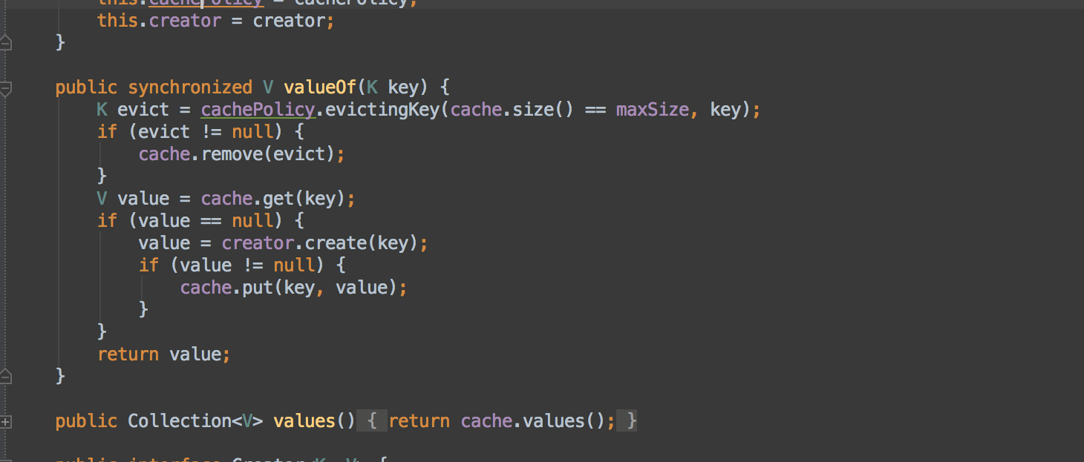


Functional Programming
Lambda Expressions
Advanced
C#
SoftUni Team
Technical Trainers
Software University
http://softuni.bg

Slide 2

Table of Contents
Functional Programming Paradigms
Lambda Expressions
Action<T>, Func<T>
Passing Functions to Methods
λ

Slide 3
Questions
sli.do #CSharpAdvanced

Slide 4
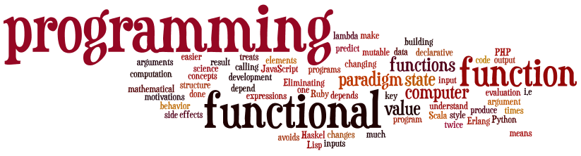
Functional Programming
Paradigms, Concepts
Notes:
Functional programming is a programming paradigm
Uses computations of mathematical functions to build programs
Declarative programming paradigm (not imperative)
Pure-functional languages (no variables and loops): Haskell
Almost-functional: Clojure, Lisp, Scheme, Scala, F#, JavaScript
Imperative with functional support: C#, Python, Ruby, PHP, Java
Non-functional: C, Pascal, the old versions of C#, Java, C++, PHP

Slide 5
What is Function?
Mathematic function
f(x) = x²
x
f(x)
Name
3 | 9
1 | 1
0 | 0
4 | 16
-4 | 16
Input
Output
A function is a special relationship where each input has a single output.

Slide 6

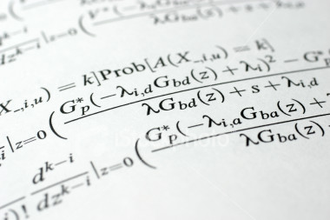
Lambda Expressions

Slide 7
Lambda Expressions
A lambda expression is an unnamed function with parameters and a body
Lambda syntax
Use the lambda operator ->
Read as "goes to"
Parameters can be enclosed in parentheses ()
The body holds the expression or statement and can be enclosed in braces {}
(parameters) -> {body}

Slide 8
Lambda Expressions (2)
Implicit lambda expression
Explicit lambda expression
Zero parameters
More parameters
msg -> System.out.println(msg);
(String msg) -> { System.out.println(msg); }
() -> { System.out.println("hi"); }
(int x, int y) -> { return x + y; }

Slide 9

Problem: Sort Even Numbers
Read Integers from console
Print even numbers
Print sorted even numbers
Use 2 Lambda Expresions
4, 2, 1, 3, 5, 7, 1, 4, 2, 12
4, 2, 4, 2, 12
2, 2, 4, 4, 12

Slide 10
Solution: Sort Odd Numbers
Console.ReadLine()
.Split(new string[] { " " },
StringSplitOptions.RemoveEmptyEntries)
.Select(n => int.Parse(n))
.Where(n => n % 2 != 0)
.OrderBy(n => n)
.ToList()
.ForEach(n => Console.WriteLine(n));
Check your solution here: https://judge.softuni.bg/Contests/597/Functional-Programming-Lab

Slide 11


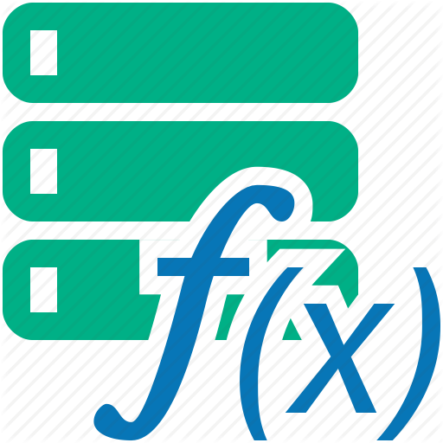
Lambda Expressions
Exercises in class

Slide 12
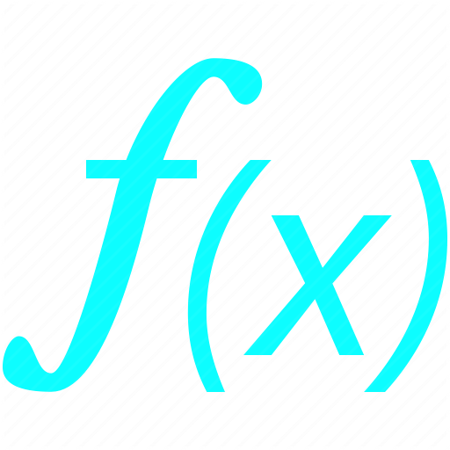




Functions
Mathematical and Java Functions
Notes:
Functional programming is a programming paradigm
Uses computations of mathematical functions to build programs
Declarative programming paradigm (not imperative)
Pure-functional languages (no variables and loops): Haskell
Almost-functional: Clojure, Lisp, Scheme, Scala, F#, JavaScript
Imperative with functional support: C#, Python, Ruby, PHP, Java
Non-functional: C, Pascal, the old versions of C#, Java, C++, PHP

Slide 13
C# Func
Lambda Expressions
Initialization of function
Input and output type can be different type
Input and output type must be from type which we declare them
Func<Integer, String> func = n -> n.toString();
Input type
Output type
Name
Input parameter
Return expression

Slide 14
Func<T, TResult>
In Java Function<T,TResult> is a interface that accepts a parameter of type T and returns type R
We use function with .apply()
int increment(int number) {
return number + 1;
}
Func<Integer, Integer> increment = number -> number + 1;
int a = increment.apply(5);
int b = increment.apply(a);

Slide 15
Action<T>
In .NET Action<T> is a void method:
Instead of writing the method we can do:
Then we use it like that:
private void Print(string message)
{ Console.WriteLine(message); }
Action<string> print = message => Console.WriteLine(message);
print(“pesho”);
print(5.ToString());

Slide 16
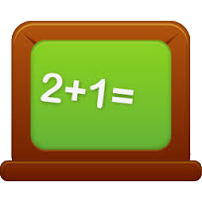

Problem: Sum Numbers
Read numbers from console
Use your own Function for parse
Print Count of numbers
Print Sum
4, 2, 1, 3, 5, 7, 1, 4, 2, 12
Count = 10
Sum = 41

Slide 17
Solution: Sum Numbers
var numbers = Console.ReadLine();
Func<string, int > parser = n => int.Parse(n);
Console.WriteLine(numbers.Split(new string[] {", "},
StringSplitOptions.RemoveEmptyEntries)
.Select(parser)
.Sum());
Check your solution here: https://judge.softuni.bg/Contests/597/Functional-Programming-Lab

Slide 18

Problem: Count Uppercase Words
Read text from console
Count how many words start with Uppercase
Print count and words
Use Predicate
The following example shows how to use Predicate
2
The
Predicate

Slide 19
Solution: Count Uppercase Words
var words = Console.ReadLine().Split(new string[] {" "},
StringSplitOptions.RemoveEmptyEntries);
Func<string, bool> checker = n => n[0] == n.ToUpper()[0];
words.Where(checker)
.ToList()
.ForEach(n => Console.WriteLine(n));
Check your solution here: https://judge.softuni.bg/Contests/597/Functional-Programming-Lab

Slide 20


Problem: Add VAT
Read from console some item's prices
Add VAT of 20% to all of them
Use UnaryOperator
Prices with VAT:
1,66
3,07
5,28
1.38, 2.56, 4.4

Slide 21
Solution: Add VAT
Console.ReadLine()
.Split(new string[] { ", " },
StringSplitOptions.RemoveEmptyEntries)
.Select(double.Parse)
.Select(n => n * 1.2)
.ToList()
.ForEach(n => Console.WriteLine($"{n:n2}"));
Check your solution here: https://judge.softuni.bg/Contests/597/Functional-Programming-Lab

Slide 22
Action<T> and Func<T>
Exercises in class

Slide 23
Passing Functions to Method
We can pass Func<T> to methods:
We can use the method like that:
private int Operation(int number, Func<int, int> operation)
{
return operation(number);
}
int a = 5;
int b = Operation(a, number => number * 5);
int c = Operation(a, number => number – 3);
int d = Operation(b, number => number % 2);

Slide 24
Problem: Filter by Age
Read from console n people with their age
Read condition and age for filter
Read format type for output
Print all people that fulfills the condition
Pesho | 20
Gosho | 18
Radka | 29
Mara | 32
Izdislav | 16
Condition - "older"
Age - 20
Format - "name age"
Pesho | 20
Radka | 29
Mara | 32

Slide 25
Solution: Filter by Age
//TODO: Read info from console
//Implementation of these methos on next slides
Func<int, bool> tester = CreateTester(condition, age);
Action<KeyValuePair<string, int>> printer =
CreatePrinter(format);
PrintFilteredStudent(people, tester, printer);
Check your solution here: https://judge.softuni.bg/Contests/597/Functional-Programming-Lab

Slide 26
Solution: Filter by Age (2)
public static Func<int, bool> CreateTester
(string condition, int age)
{
switch (condition)
{
case "younger": return x => x < age;
case "older": return x => x > age;
default: return null;
}
}
Check your solution here: https://judge.softuni.bg/Contests/597/Functional-Programming-Lab

Slide 27
Solution: Filter by Age (3)
public static Action<KeyValuePair<string, int>>
CreatePrinter(string format)
{
switch (format)
case "name":
return person => Console.WriteLine($"{person.Key}");
case "age":
return person => Console.WriteLine($"{person.Value}");
case "name age":
return person =>
Console.WriteLine($"{person.Key} – {person.Value}");
default: return null;
}
Check your solution here: https://judge.softuni.bg/Contests/597/Functional-Programming-Lab

Slide 28
Passing Functions to Method
Exercises in class

Slide 29
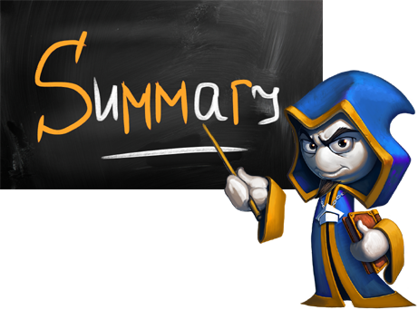
Summary
Lambda expressions are anonymous functions used with delegates
Action<T> is a void function
Func<T, TResult> is a function that returns TResult type

Slide 30








Functional Programming
https://softuni.bg/courses/advanced-csharp

Slide 31

License
This course (slides, examples, demos, videos, homework, etc.) is licensed under the "Creative Commons Attribution-NonCommercial-ShareAlike 4.0 International" license
Attribution: this work may contain portions from
"Fundamentals of Computer Programming with C#" book by Svetlin Nakov & Co. under CC-BY-SA license
"OOP" course by Telerik Academy under CC-BY-NC-SA license

Slide 32






Free Trainings @ Software University
Software University Foundation – softuni.org
Software University – High-Quality Education, Profession and Job for Software Developers
softuni.bg
Software University @ Facebook
facebook.com/SoftwareUniversity
Software University @ YouTube
youtube.com/SoftwareUniversity
Software University Forums – forum.softuni.bg

